Slide 1


Connecting to Community after Intimate Partner Violence
Jen Johnson, PhD*
Bernouse Davilus, RSW, MSW
Marlene Gorman, RSW, MSW
KH Innovations Conference, Toronto
13:30 EST 02/10/25
Building Opportunities for Women (B.O.W.)
Notes:
*Presenting contributor
**Sudbury YWCA Genevra House is located in N’Swakamok. The work of the BOW Program takes place on the traditional territories of Atikameksheng Anishnawbek First Nation and Wahnapitae First Nation. We recognize the Robinson-Huron Treaty of 1850.

Slide 2





KNOWLEDGE HUB
CENTRE DE CONNAISSANCES
presents:
Innovations in Addressing Gender-Based Violence and Trauma- and Violence-Informed Health Promotion
A NATIONAL CONFERENCE
Oct 1–2, 2025

Slide 3
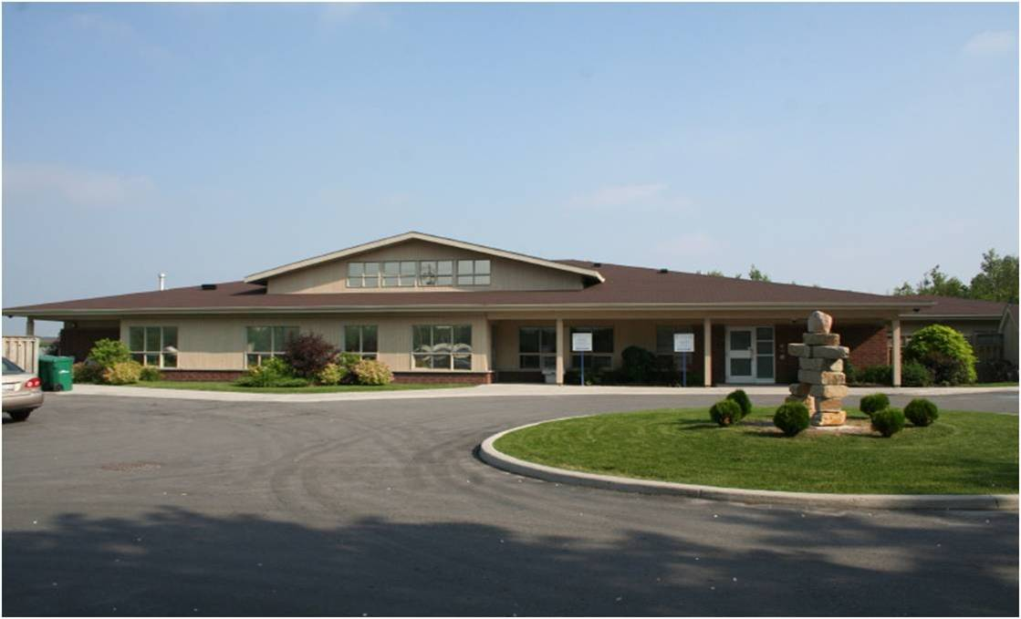
Sudbury YWCA Genevra House is located in N’Swakamok. The work of the BOW Program takes place on the traditional territories of Atikameksheng Anishnawbek First Nation and Wahnapitae First Nation. We recognize the Robinson-Huron Treaty of 1850.
Notes:
Alt-text: image of Sudbury YWCA Genevra House buildings. A circular driveway leads up to a large bungalow-style building. The sky above is blue and there are green trees and grass in front of the building.

Slide 4
Learning Objectives
By the end of this presentation, participants will know more about:
The establishment of the BOW Program as a virtual and in-person group support for women in Northeastern Ontario
The significance of participant-led methodologies for addressing intimate partner violence in the context of Northeastern Ontario
The importance of program evaluation and participants’ responses to the BOW Program

Slide 5
What is the BOW Program?
The BOW Program is a 12-week support group for women 16+ who self-identify as having experienced, or feel they are at risk of experiencing, intimate partner violence.

Slide 6
What is the BOW Program?
With the ultimate goal of health promotion, participants learn about gendered violence, and personal, social and financial awareness and skills
Trauma-informed and culturally relevant approaches applied
  Remote or in-person delivery to 10-15 people at a time
  Skilled facilitation over 12 weeks
  Referrals and resources

Slide 7
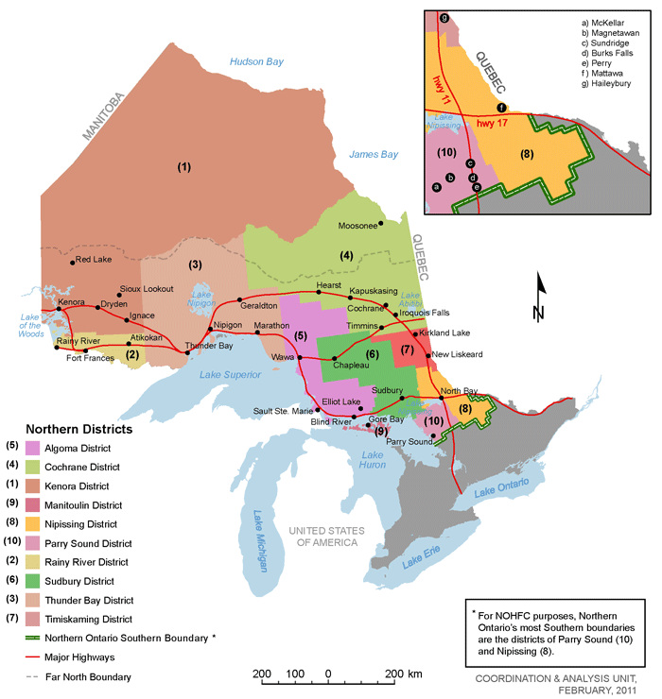
Where is the BOW Program located?
Notes:
Alt-text: Image is a colourful map of Ontario, Canada. The Northern Districts of Ontario are each represented with a different colour. The Districts are super-imposed on towns, cities, and major highways across Northern Ontario. For the purpose of this presentation, Sudbury & District is coloured in bright green and labelled as #6 on the map. This is the only District served by YWCA Sudbury’s BOW Program. The District goes as far south as the town of Parry Sound, east just before North Bay, west to just before Elliot Lake, and just North of Chapleau. For further accessible interpretation of this map please contact the presenters. The source of the map is The Ontario Genealogical Society: https://www.ogs.on.ca/sudbury/sudbury-district-maps.html

Slide 8
Who are the participants?
Self-identified women, ages 16-84
Formal education: < gr 10 - postgraduates
Language: English, French, Urdu, Luganda, Gujarati, Hindi, Farsi and Spanish
~ 30-40% of participants self-identify as Black, racialized, Indigenous
Commonalities: isolation from peers, family, and local services; unsure how to improve access to education, housing and healthcare; interest in learning more about gendered violence

Slide 9
The BOW Program reached 111 participants between
2023-2025
Group 1 - 14 registered, 9 completed
Group 2 - 9 registered, 5 completed
Group 3 - 6 registered, 6 completed
Group 4 - 6 registered, 6 completed
Group 5 - 11 registered, 9 completed
Group 6 - 6 registered, 5 completed
Group 7 - 36 registered, 25 completed
Group 8 - 23 registered, 20 completed
Group 9 - 30 registered, 25 completed
Group 10 --
Group 11 --

Slide 10
The BOW Program Curriculum
Week 1: Introduction and goal-setting
Week 2: Identify abuse and unhealthy relationships
Week 3: Staying safe and free from abuse
Week 4: Stress management and relaxation
Week 5: Communication skills
Week 6: Responding to change

Slide 11
The BOW Program Curriculum
Week 7: The change challenge
Week 8: Self-esteem - feeling good about ourselves
Week 9: Looking at our labels
Week 10: Decision making
Week 11: Budgeting and survival on a low income/financial literacy
Week 12: Affirming ourselves

Slide 12
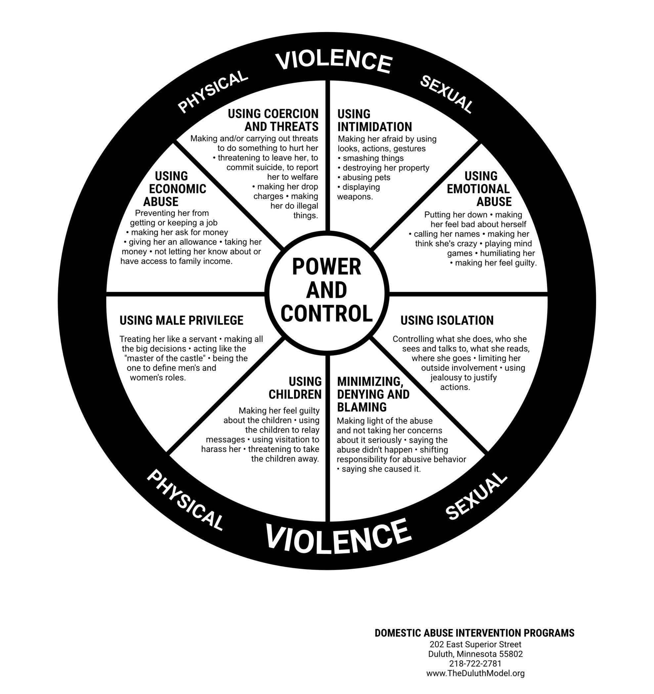
The BOW Program Curriculum
Example of one workshop’s visual content

Slide 13

The BOW Program Curriculum
Telling Our Stories: Immigrant Women’s Resilience
(Ontario Council of Agencies Serving Immigrants, 2017)
Notes:
Reference: Telling Our Stories: Immigrant Women’s Resilience (Ontario Council of Agencies Serving Immigrants, 2017)
Link to this resource https://ocasi.org/campaigns/4ImmigrantWomen)
Alt-text: This slide shows the front cover of the publication ’Telling Our Stories’. The image includes the hand-drawn images of four people who are reading the graphic novel ’Telling Our Stories’. The figures have skin tones that range from light to dark brown and are wearing brightly coloured clothes. One figure in the foreground wears a bright pink headscarf while the other is wearing their hair in a bun, both figures are reading the graphic novel. The other two figures in the background are catching or maybe releasing copies of the novel up into the sky. The copies of the novel are all blue and appear to float above the figures like birds.

Slide 14
Participant-led Methodologies
The BOW Program Methodology is premised on the importance of:
  Connection
  Reflection
  Skill-building
These elements are built into the curriculum, an ongoing program evaluation and a qualitative research intervention

Slide 15
Connection
Meaningful connections are essential to empowering participants to get the most out of the group, to access services they are entitled to in the community. “What did you like most?”:
“Learning your own worth”; “To share with different people” (Group 4)
“Feeling support for newcomer and woman issues” (Group 3)

Slide 16
Self-Reflection
Opportunity for self-reflection:
Participants express improved confidence to test their knowledge and beliefs. For example:
“[I learned] Decision making and [how to be] responsive to the change”...and “How strong I am and how I love to help others (Group 5)
“I was looking for a safe space to, you know, rebuild…explore new opportunities…I’ve started planning for, for doing my education. And I feel more confident now.” (Group 9)

Slide 17
Skill-Building
Skill-building: The format of the BOW Program allows for focused thematic discussions into which resources can be introduced. Participants are prompted to offer suggestions about skills and topics they want to know more about. For example, many participants indicated the workshops help them learn:
“How to be confident”
(Multiple participants, 2022-2025)

Slide 18
Participant-driven methodologies are reflected in:
Curriculum development
Facilitation
Program evaluation
Notes:
Alt-text : image of Sudbury YWCA Genevra House buildings. A circular driveway leads up to a large bungalow-style building. The sky above is blue and there are green trees and grass in front of the building.
Texte alternatif : image des bâtiments de la maison Genevra de la YWCA de Sudbury. Une allée circulaire mène à un grand bâtiment de style bungalow. Le ciel est bleu et il y a des arbres verts et de l’herbe devant le bâtiment.

Slide 19
Curriculum development:
Participants require BOW to be responsive - program evaluation
“I didn’t realize until I was much older that I had been in abusive relationships…I grew up in a house where there was violence around,… when I got married... it was just the norm… you’re not getting hit, but you’re being bullied, you’re being manipulated for your money, you’re being gaslit, you’re being… like, this is still abuse.”(Group 9)

Slide 20
Curriculum development:
Responsive to experience and new results from program evals
“And then the financial literacy piece, like teaching you how to budget properly, teaching you… Like, nobody ever taught me about interest rates on credit cards. So, like, if I had been a 30-something or a 20-something woman, and had been able to learn about that, we may not have ended up bankrupt.” (Group 9)

Slide 21
Facilitation:
Helps participants make connections independently
“The one thing that helped me was not learning directly from just the facilitator. There were most topics where there was a collaborative discussion, and rooms with participants of the program. So, that helped me… to learn from the views of individual women who were partaking in the program.” (Group 9)

Slide 22
Program Evaluation:
Reflects impact of the BOW Program
“One person in program told me ‘I am enough. I am loved, I am valued’, and… she said to me that I am precious, you know? … I’ve never received such positive words before, and that actually helped me. In fact, it was a great experience. I was able to tell someone else that they feel loved, they are loved. They are kind. That was a big, … That was a big thing for me.” (Group 9)

Slide 23
Program Evaluation:
Reflects impact of the BOW Program
“After the BOW, I got to realize that not every word from my husband or my spouse is… is normal. There are some that is actually affecting my mental health… after the program, I was able to communicate it to my husband, .. he doesn’t beat me, you know. He knows how to talk down on me, and… like, make me feel bad or worthless. So I was able to communicate what I learned from the program to him. And, to be sincere, he was… he was… he apologized, and, you know… And promised to make amends.” (Group 9)

Slide 24
Project Impact, 111 participants:
90 % participants report changes in knowledge and/or skills
90% participants report changes in behaviour
82% participants report improved health outcomes
Notes:
Alt-text : image of Sudbury YWCA Genevra House buildings. A circular driveway leads up to a large bungalow-style building. The sky above is blue and there are green trees and grass in front of the building.
Texte alternatif : image des bâtiments de la maison Genevra de la YWCA de Sudbury. Une allée circulaire mène à un grand bâtiment de style bungalow. Le ciel est bleu et il y a des arbres verts et de l’herbe devant le bâtiment.

Slide 25
Conclusions
The BOW Program is not a substitute for individual and institutional accountability for ending violence in Northeastern communities
The BOW Program helps participants reconnect to community after intimate partner violence and some feel it could even be preventative

Slide 26
Conclusions
Participant-centred methodologies for addressing intimate partner violence help create and maintain flexible, responsive and effective programs

Slide 27
Thank you Merci Miigwech
Jen Johnson* Program Evaluator and Lead
Researcher
jljohnson@laurentian.ca
Bernouse Davilus BOW Program Facilitator
Marlene Gorman Executive Director
YWCA Sudbury
* presenting co-author

